Slide 1
PHYS4260 Quantum Mechanics II Spring 2025
Symmetries and Conservation laws

Slide 2
Outline
Parity in 3Dim
Wu’s Experiment
Parity and selection rules: Laporte’s Rule
Rotations
Rotations in 3Dim
Degeneracy
Selection Rules

Slide 3
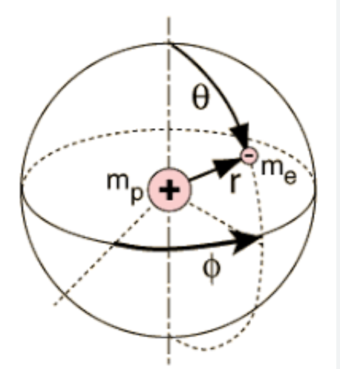
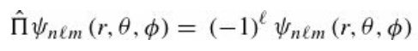
Recap: Parity in 3Dim
In three dimensions, the Hamiltonian for a particle of mass $m$ moving in a potential $V(r)$ will have
inversion symmetry if $V\left(−r\right)=V(r)$.
Importantly, any central potential satisfies this condition. As in the one-dimensional case, parity is conserved for such systems, and the eigenstates of the Hamiltonian may be chosen to be simultaneously eigenstates of parity. It’s not difficult to prove that the eigenstates of a particle in a central potential, which are written as
are eigenstates of parity

Slide 4
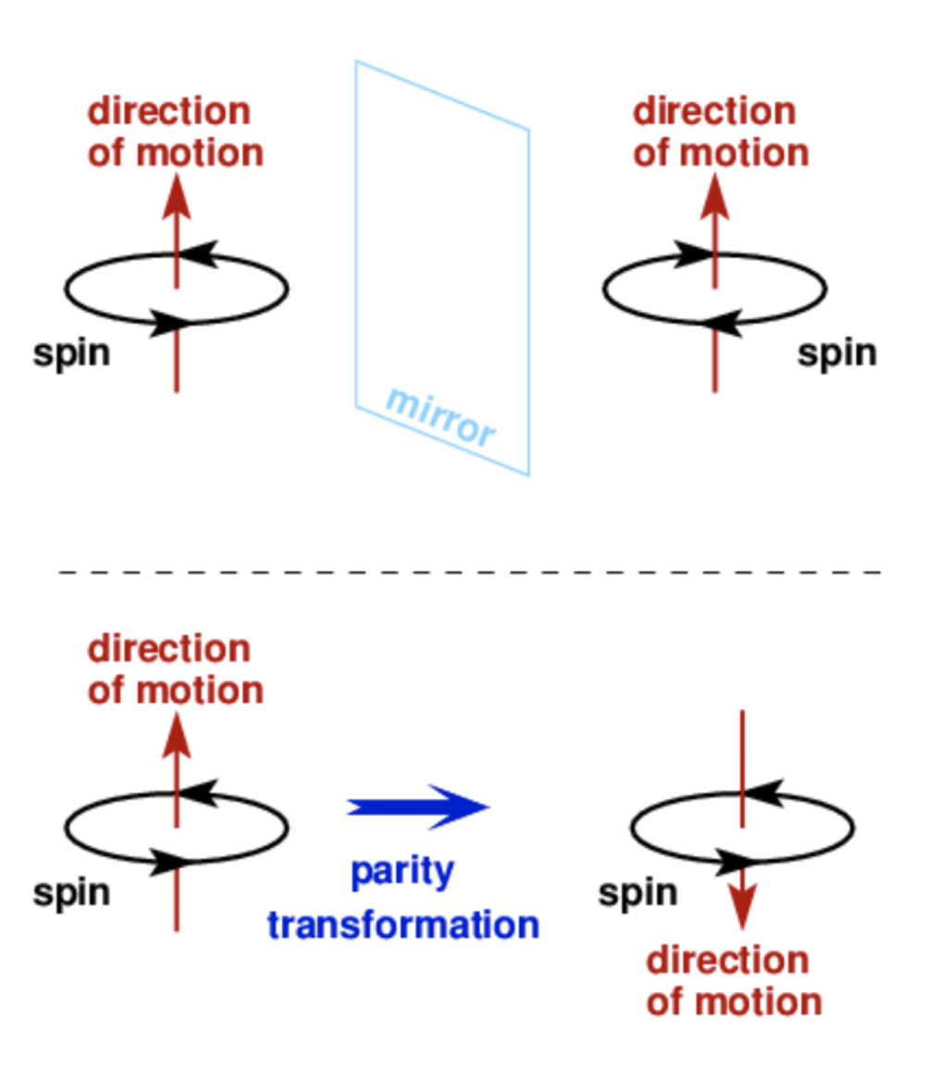
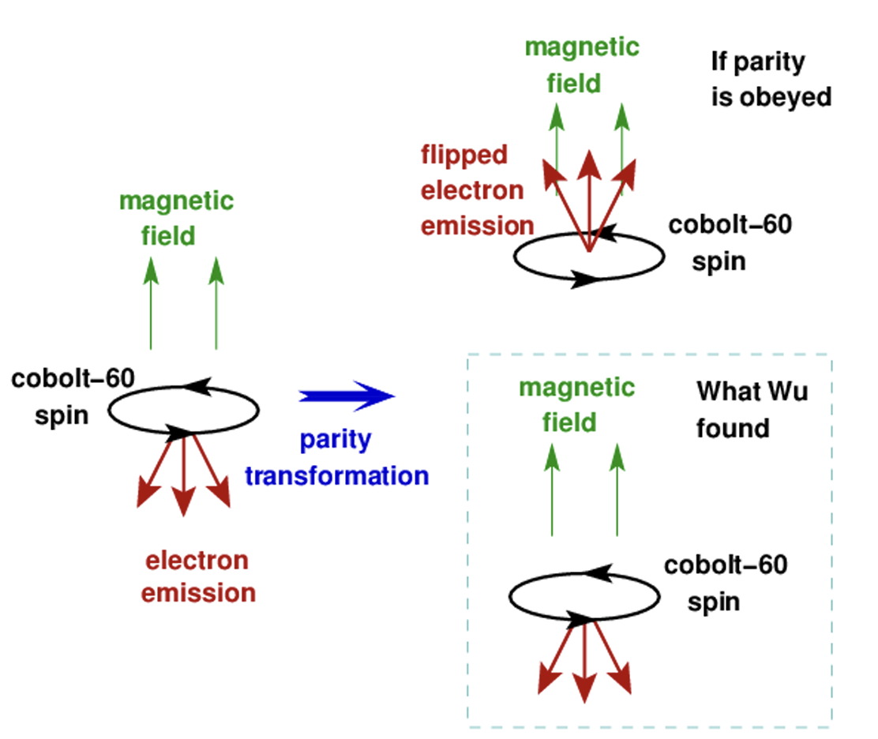
Parity in 3Dim: The spin example
$$y$$
A mirror reflection flips just one of the three components of the position vector (𝑥,𝑦,𝑧).
A parity transformation flips all three components of the position vector:
(𝑥,𝑦,𝑧) becomes (−𝑥,−𝑦,−𝑧).
$$x$$
Parity violation in the Wu’s experiment (next slide)

Slide 5
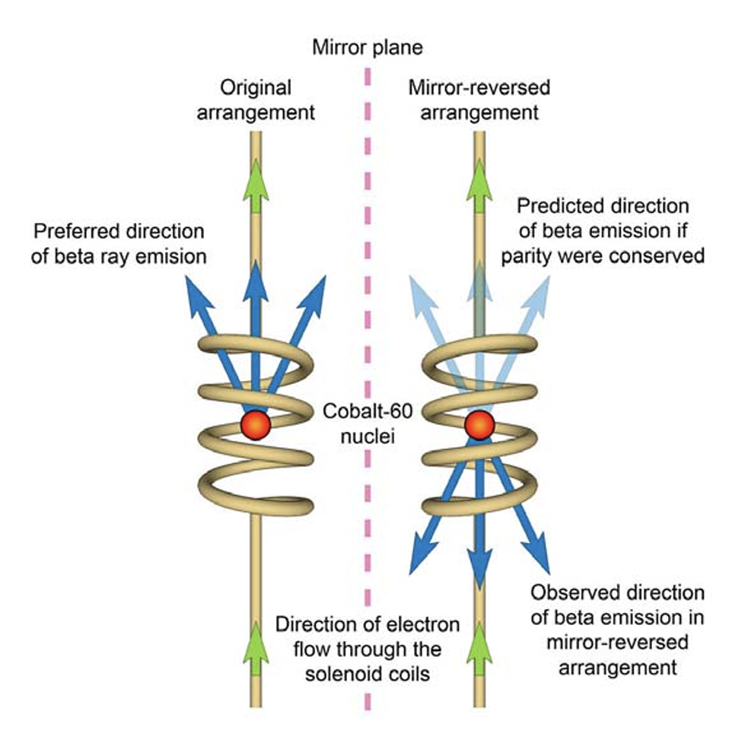
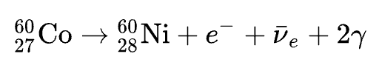
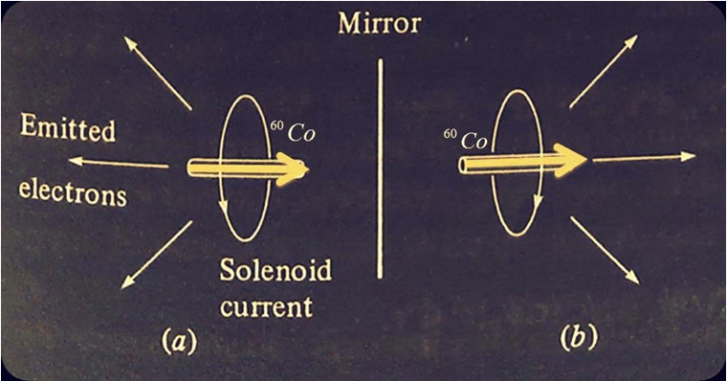

Wu’s Experiment
Physics experiment conducted by Chien-Shiung Wu in 1956, which demonstrated that parity is not conserved in weak interactions
Parity transf.
Parity conserving situation
Very low temperatures were used so that random thermal motion was negligible, enabling a strong magnetic field to align the cobalt nuclei with their spins parallel. The number of emitted electrons was counted in two directions: upward and downward. It was found that the emission of electrons was much greater in the downward direction – the south pole of the spinning nuclei – than the upward direction.
The fact that the real-life experiment with reversed spin direction behaved differently from the mirror image proved that parity is violated in the weak interaction of beta decay. The same conclusion – that the weak force does not conserve parity

Slide 6
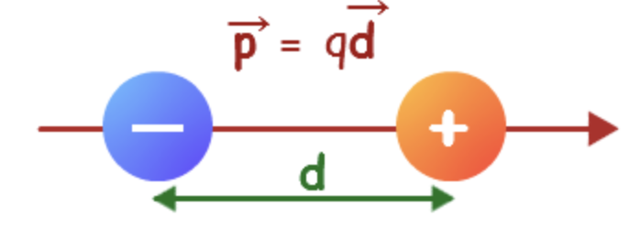
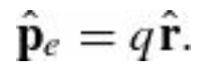
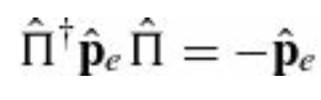
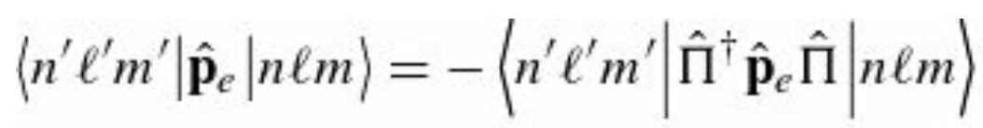
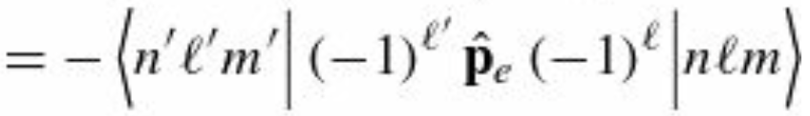
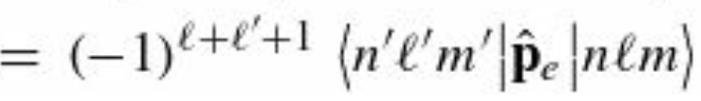
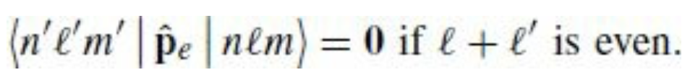
Parity in 3Dim: Selection rules
Selection rules tell you when a matrix element is zero based on the symmetry of the situation. Recall that a matrix element is any object of the form $\left\langle b|\hat{Q}|a\right\rangle$ an expectation value is a special case of a matrix element with $a=b=ψ$. One operator whose selection rules are physically important is the electric dipole moment operator
The selection rules for this operator—the operator itself is nothing more than the charge of the particle times its position—determine which atomic transitions are allowed and which are forbidden. It is odd under parity since the position vector $\hat{r}$ is odd
Now consider the matrix elements of the electric dipole operator between two states $ψ_{n,l,m}$ and $ψ_{n′,l′,m′}$
From this we see immediately that
Laporte’s rule. It can be generalized to any operator, as long as you
know how that operator transforms under parity

Slide 7
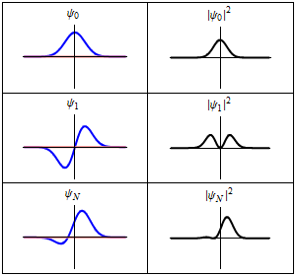
Parity in 3Dim: Selection rules
Three wavefunction solutions to the time-dependent Schrödinger equation for an electron in a harmonic oscillator potential.
Left: The real part (blue) and imaginary part (red) of the wavefunction. Right: The probability of finding the particle at a certain position.
The top row is an energy eigenstate with low energy, the middle row is an energy eigenstate with higher energy, and the bottom is a quantum superposition mixing those two states.
The bottom-right shows that the electron is moving back and forth in the superposition state.
This motion causes an oscillating electric dipole moment, which in turn is proportional to the transition dipole moment between the two eigenstates.

Slide 8
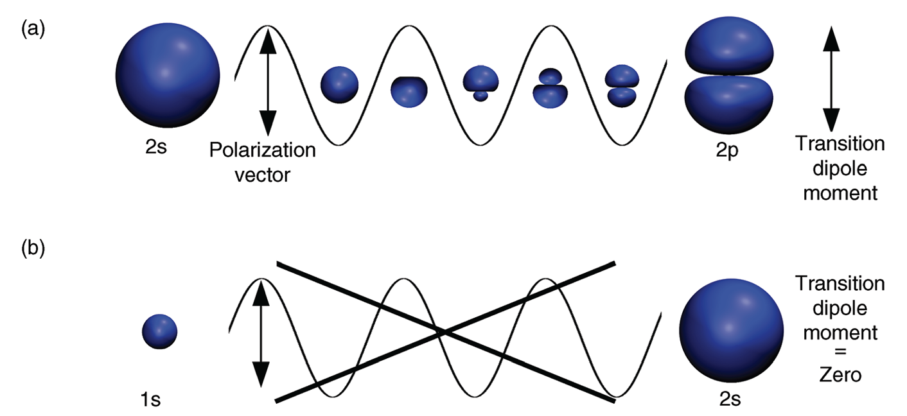
Parity in 3Dim: Selection rules
An example of an electron dipole moment transition is the transition between the 1s and 2p orbitals in a hydrogen atom;
this is considered an "allowed" transition because the change in the angular momentum quantum number $l=+1$,
which aligns with the selection rules for electric dipole transitions
The oscillating electric field component of light
can induce a transition from an s to a p orbital
when it has the correct polarization (direction
of oscillating electric field component of light)

Slide 9
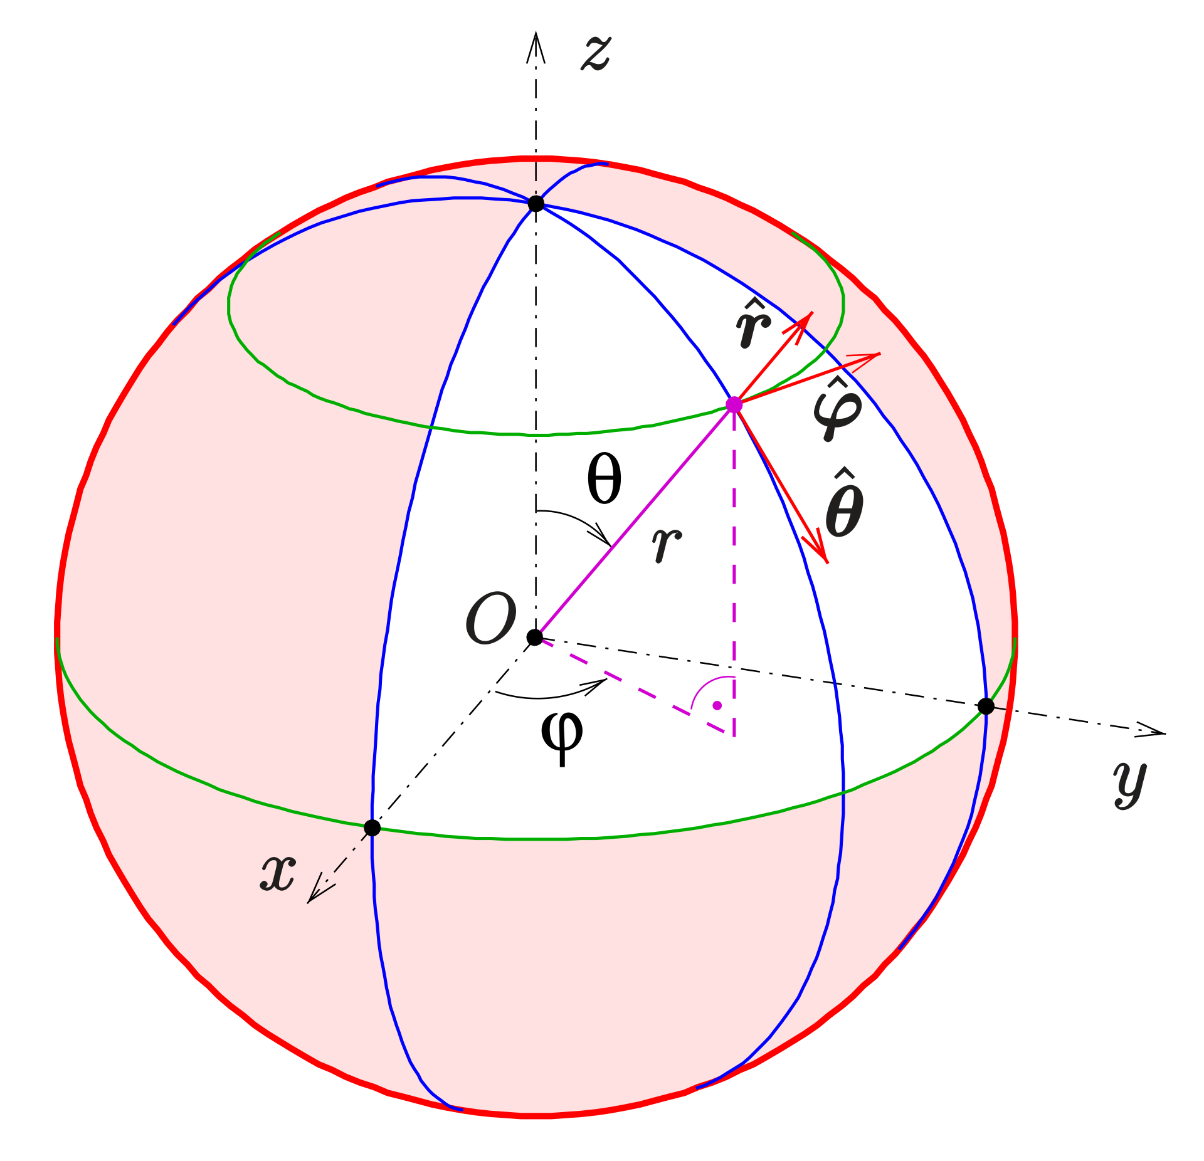
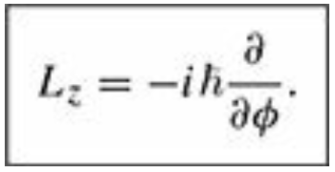
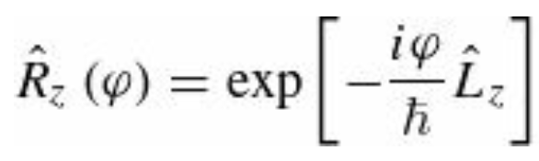
Rotational Symmetry
The operator that rotates a function about the z axis by an angle $φ$ is
is closely related to the z component of the angular momentum.
By the same reasoning that led to equation for the translation operator, we can write
And we say that $L_{z}$ is the generator of rotations about the z axis

Slide 10
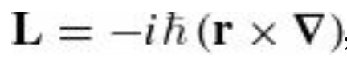
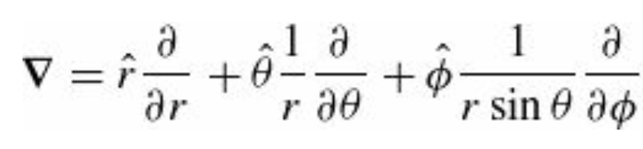

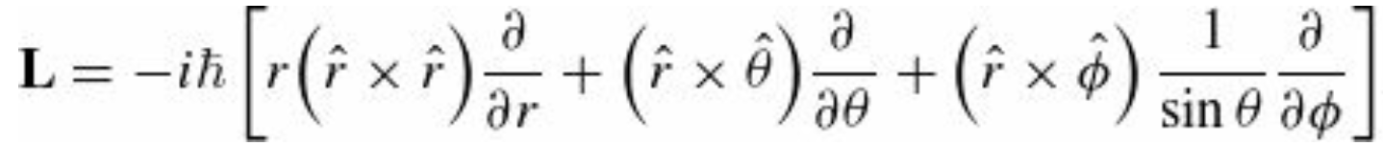
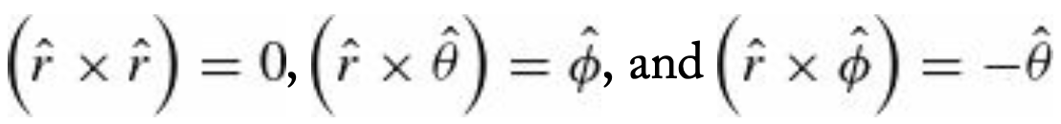
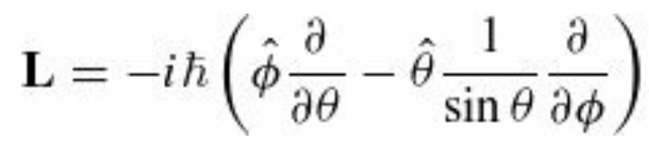
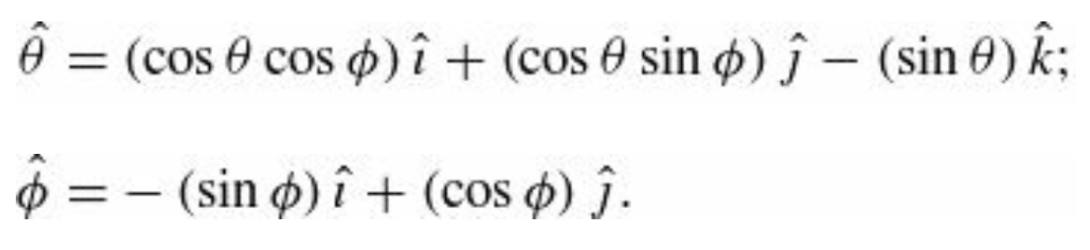
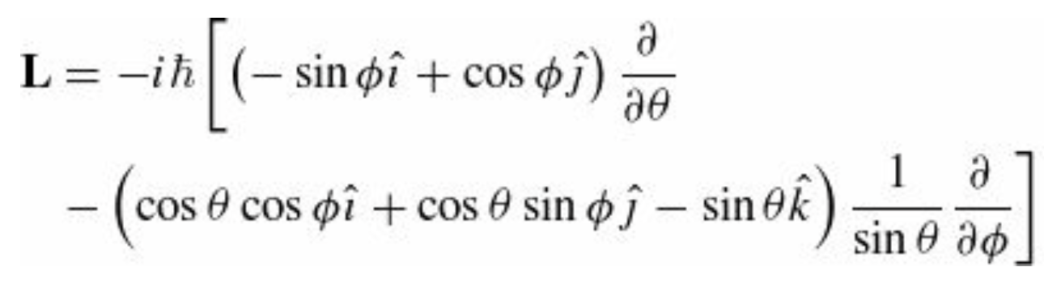
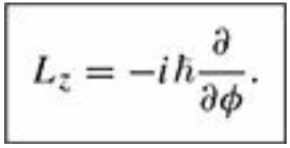
Operators in Spherical coordinates
*Note: The book represents vectors with boldface characters
The gradient in spherical coordinates is
Therefore, the Angular Momentum is
Expressing the angular variables in terms of the cartesian ones

Slide 11
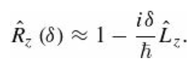
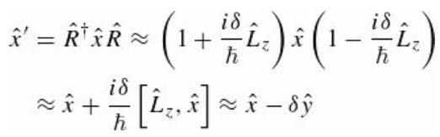
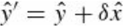
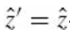
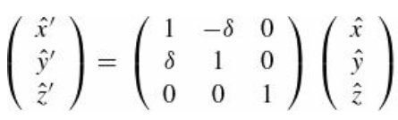
Transformation of $\hat{r}$ and $\hat{p}$ under rotations
How do the operators for position and momentum transform under rotations? To answer this question, we use the
infinitesimal form of the operator:
Then the operator $\hat{x}$ for example transforms as
Similar calculations show that and .
We can combine these results into a matrix equation

Slide 12
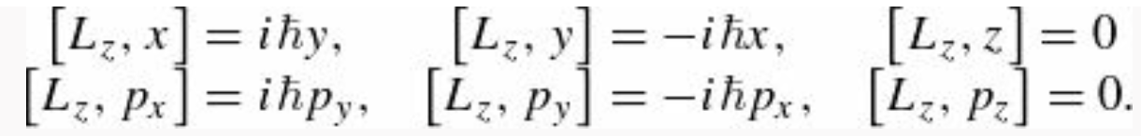
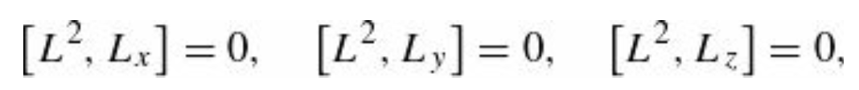
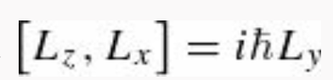
Commutation relations from QM I
You should be familiar with there relations from Quantum Mechanics I (See Ch 4 of the Textbook)

Slide 13
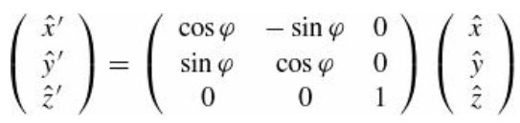
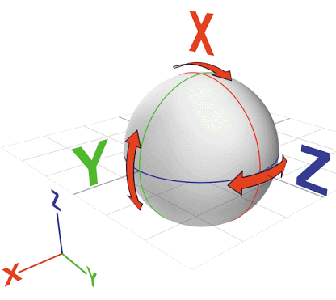
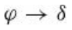
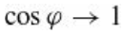
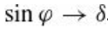
Transformation of $\hat{r}$ and $\hat{p}$ under rotations
But we must be careful because
represents an infinitesimal rotation where higher order terms in the Taylor series are dropped. The full expression is
and when the rotation is infinitesimal.

Slide 14
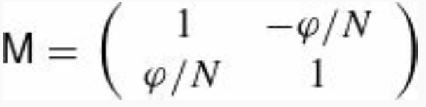
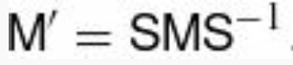
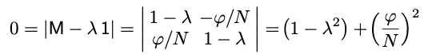

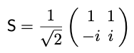
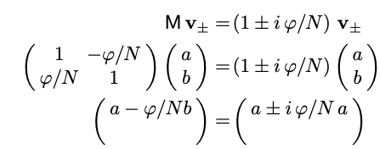
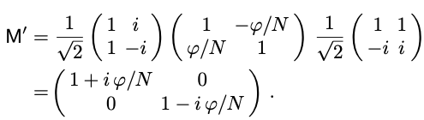
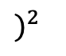
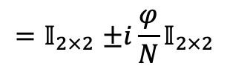
Infinitesimal and finite rotation transformations
Before moving forward, it will be a good exercise to analyze the correspondence between infinitesimal and finite
rotation transformations.
Our infinitesimal transformation can be written as
$$δ=φ/N$$
We start by diagonalizing M and obtain where $S^{−1}$ is the unitary matrix whose columns are the
(normalized) eigenvectors of M. We compute the eigenvalues
$)^{2}$
The eigenvectors are
$$−1$$
And the $S^{−1}$ matrix from the eigenvector matrix is
The M’ matrix now reads
So that
$${=𝕀}_{2×2}±i\frac{φ}{N}𝕀_{2×2}$$

Slide 15
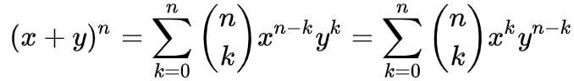
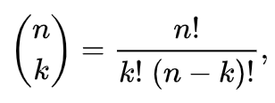








Infinitesimal and finite rotation transformations
We use the binomial expansion
to show that is a diagonal matrix with entries $e^{−iφ}$ and $e^{iφ}$ on the diagonal. In fact,
and the coefficient
$$→$$
1 in the limit that $N → ∞$ and
Therefore
Having all the ingredients, we transform back

Slide 16






Rotations in 3Dim
can be generalized in the obvious way to a rotation about an axis along the unit vector $n$
Just as linear momentum is the generator of translations, angular momentum is the generator of rotations. Any operator (with three components) that transforms the same way as the position operator under rotations is called a vector operator. By “transforms the same way” we mean that
For a rotation about the z axis, we would have
Where $D$ is the same matrix as appears in

Slide 17



Rotations in 3Dim and Angular Momentum
This transformation rule follows from the commutation relations
Levi-Civita Symbol
which we may take as the definition of a vector operator. So far, we have encountered three such operators $\hat{r}$ , $\hat{p}$ , and $\hat{L}$
A scalar operator is a single quantity that is unchanged by rotations; this is equivalent to saying that the operator commutes with

Slide 18



Operator Classification
We can now classify operators as either scalars or vectors, based on their commutation relations with $\hat{L}$, (how they transform under a rotation), and as “true” or pseudo-quantities, based on their commutators with $\hat{Π}$ (how they transform under parity). These results are summarized in the table below
Note the appearance of anticommutators for pseudo vectors and pseudo scalars!
To include the spin $\hat{S}$ one simply replaces ${\hat{L}}_{i}$everywhere it appears in the third column with ${\hat{J}}_{i}={\hat{L}}_{i}+{\hat{S}}_{i}$.
$\hat{S}$ like $\hat{L}$ is a pseudo vector, while $\hat{p}∙\hat{S}$ is a pseudo scalar.

